Slide 1

New and Old Book Purchase System(Book Wala)
Under the guidance of
Dr. Sheikh Fahad Ahmad

Slide 2
Team Members
UID | Name
2110030031 | Sumeet Sharma
2110030109 | D. Harshavardhan Reddy
2110030190 | K. Sai Vardhan Reddy
2110030252 | Mohammed Afeef Sayeed

Slide 3

What is Bookstore Management System?
Bookstore management system mainly focuses on the activities of a book store such as information on books and books sold to customers.
The database flexibility, convenient features, the maximum increase in customer service, access to accurate information make this ideal for all sizes of book stores.

Slide 4
DATA SET COLLECTIONS
User{u_ID,u_Name,u_Username,u_Password,u_gender,u_email,u_contact,u_city}
Contact{con_id, con_name, con_email, con_query}
Book{Book_ID, Book_Name, Book_desc, Book_Publisher, Book_Price, Book_NoPages, Book_Img}
Cart{Cart_ID,Book_ID,User_Name,Cost,Book_Name,Quantity}
CheckOut(Order_ID,Cart_ID,Order_Date,Total_Amount}

Slide 5
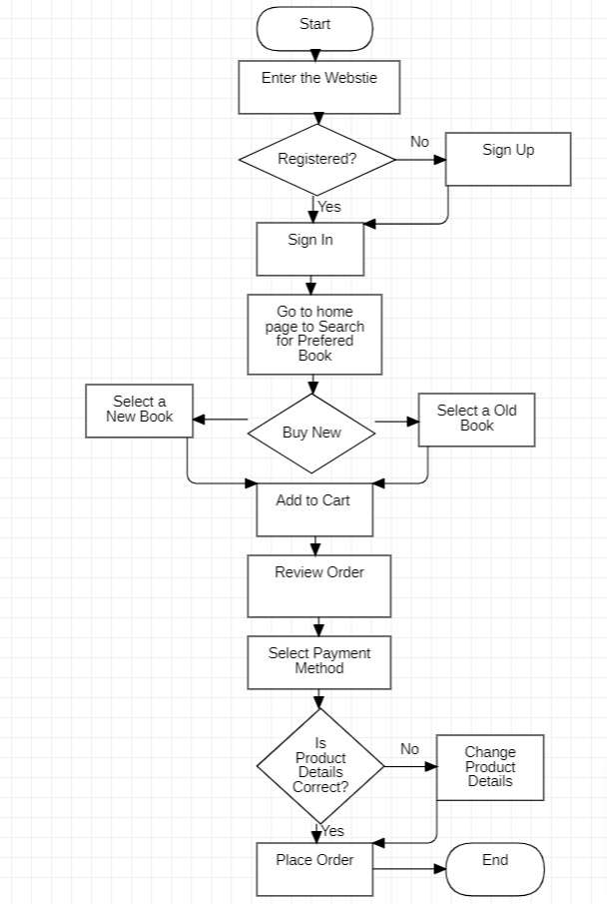
FLOW CHART

Slide 6
Modules
Registration
Search The Book
Purchase The Book
Payment
Feedback

Slide 7
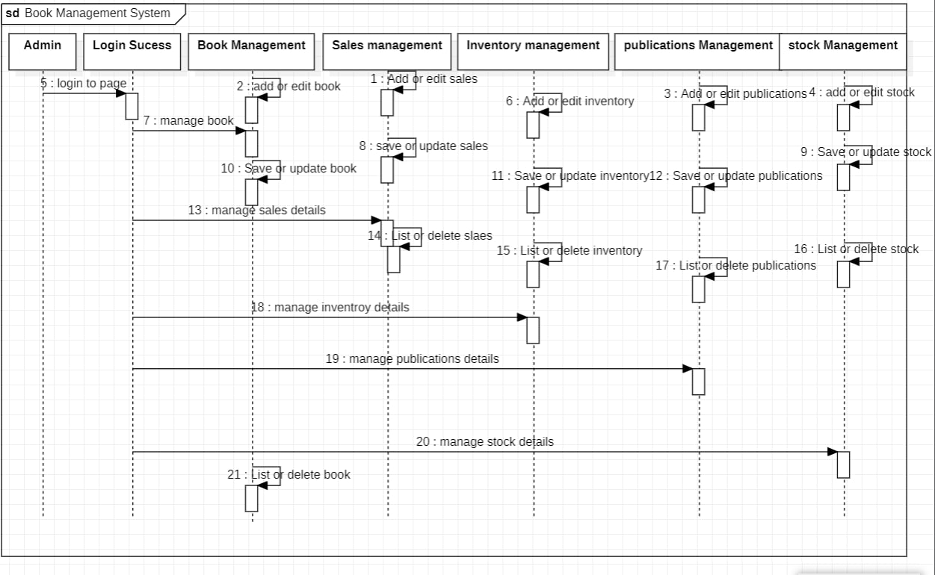
Sequence Diagram

Slide 8
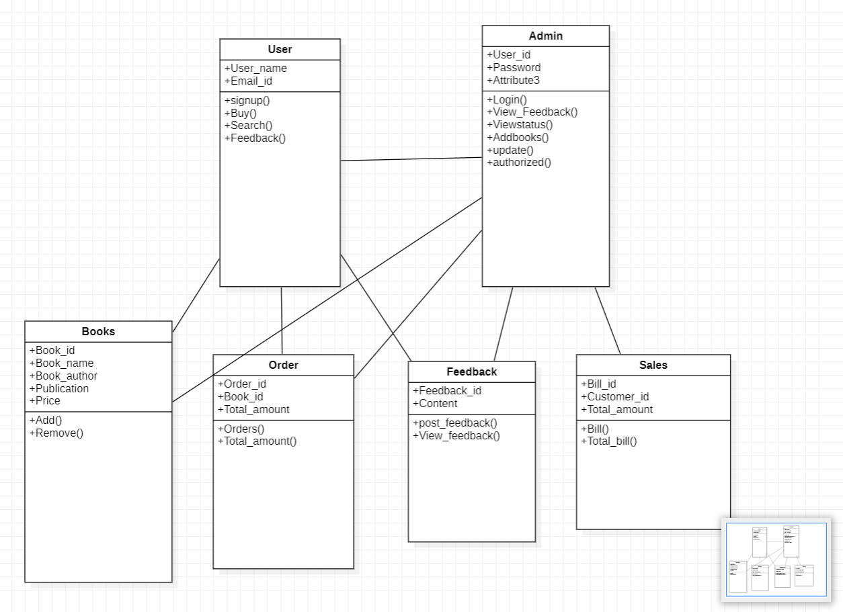
Class Diagram

Slide 9
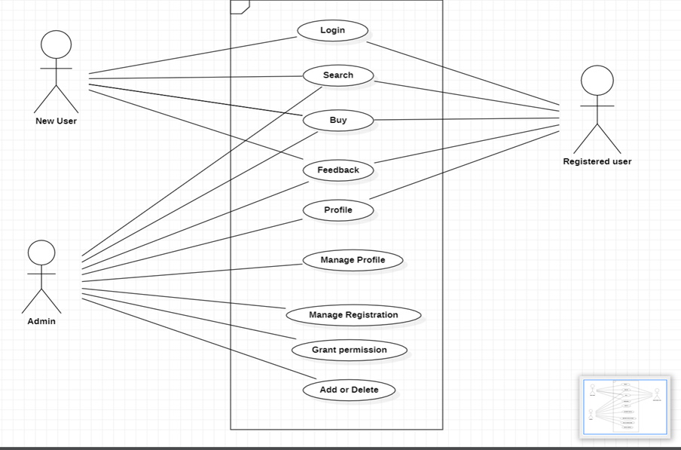
Use Case Diagram

Slide 10
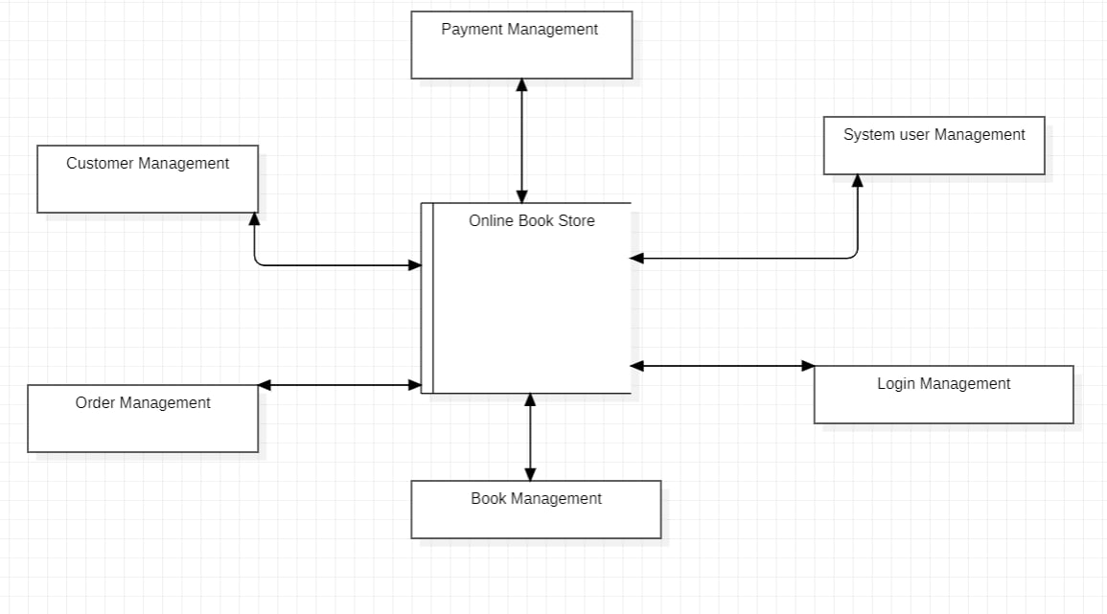
Data Flow Diagram

Slide 11



Data Structures needed
Tools:
StarUML
MySQl
Python
CSS
HTML

Slide 12

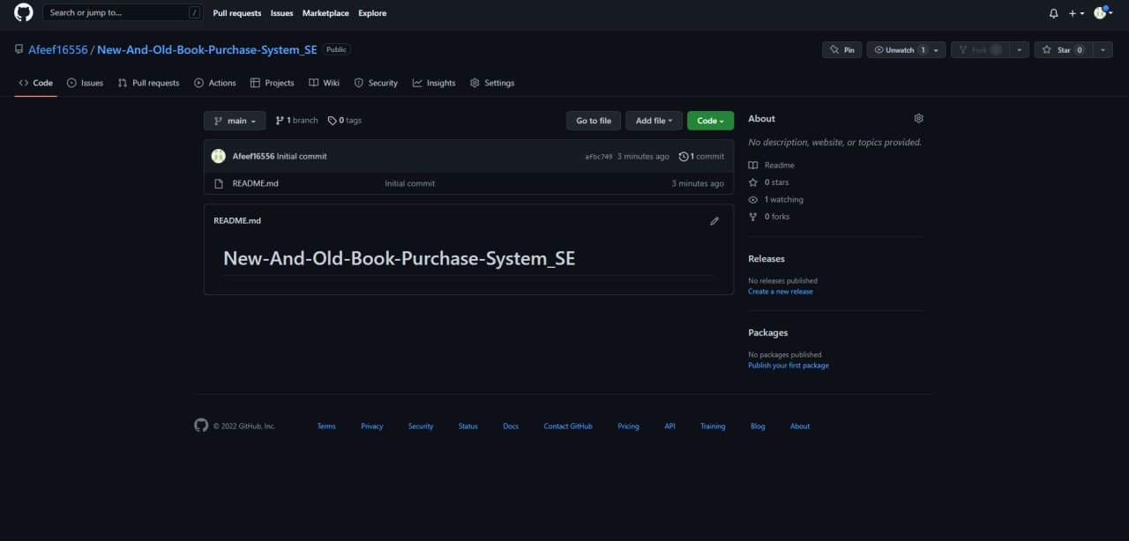
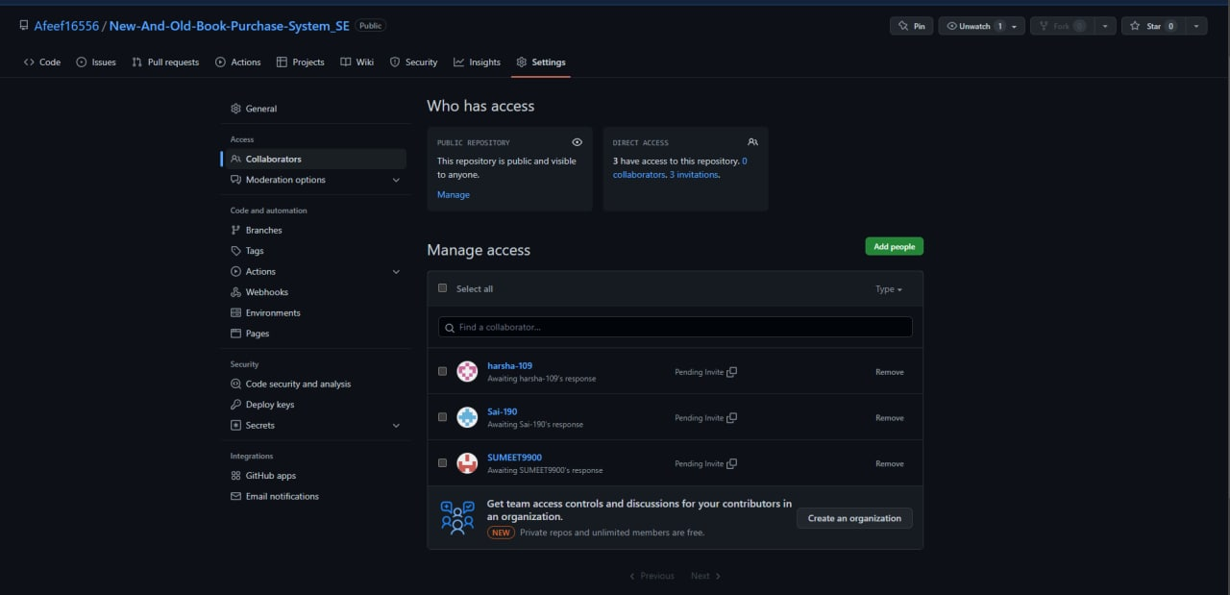
Github setup
https://github.com/Afeef16556/New-And-Old-Book-Purchase-System_SE

Slide 13
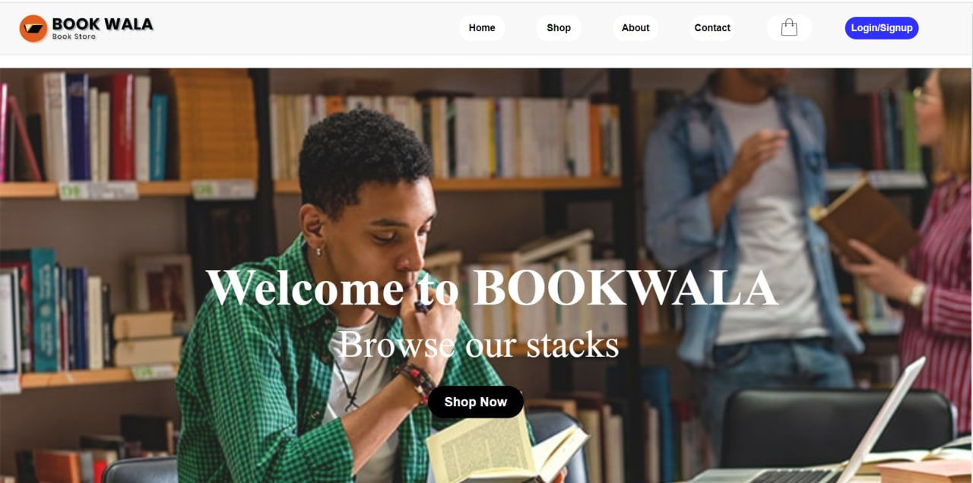
Work In progress

Slide 14
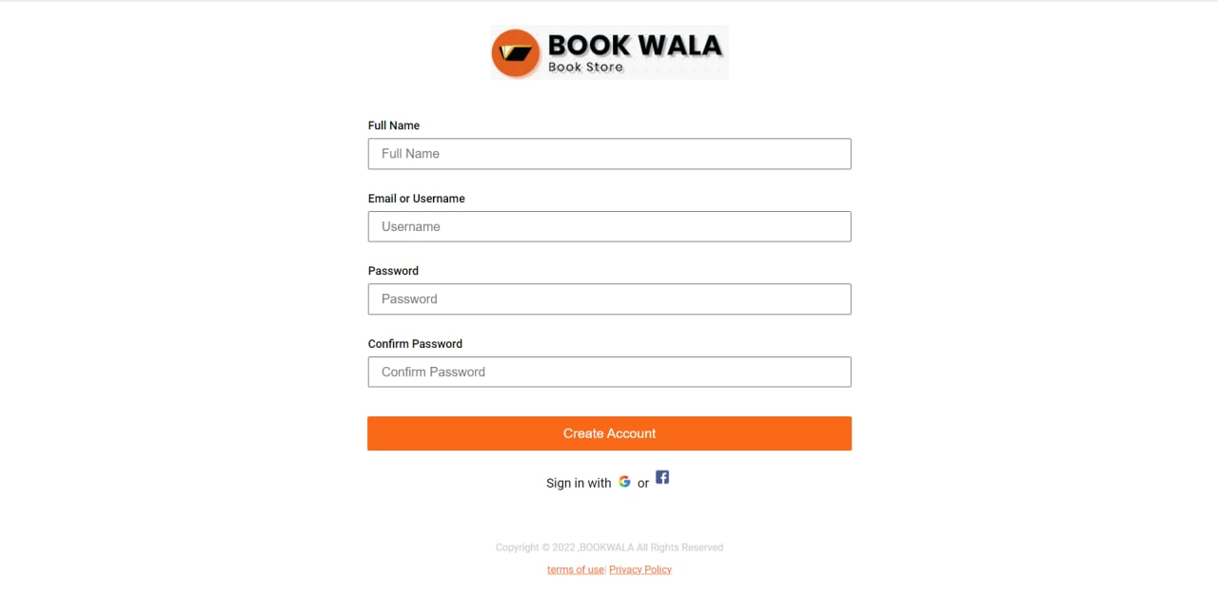

Slide 15
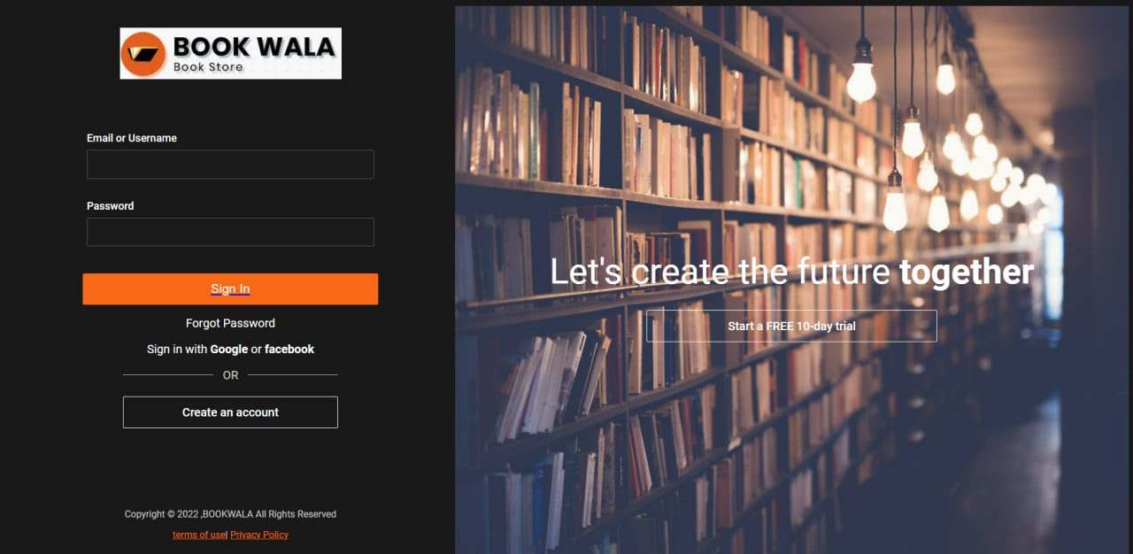

Slide 16
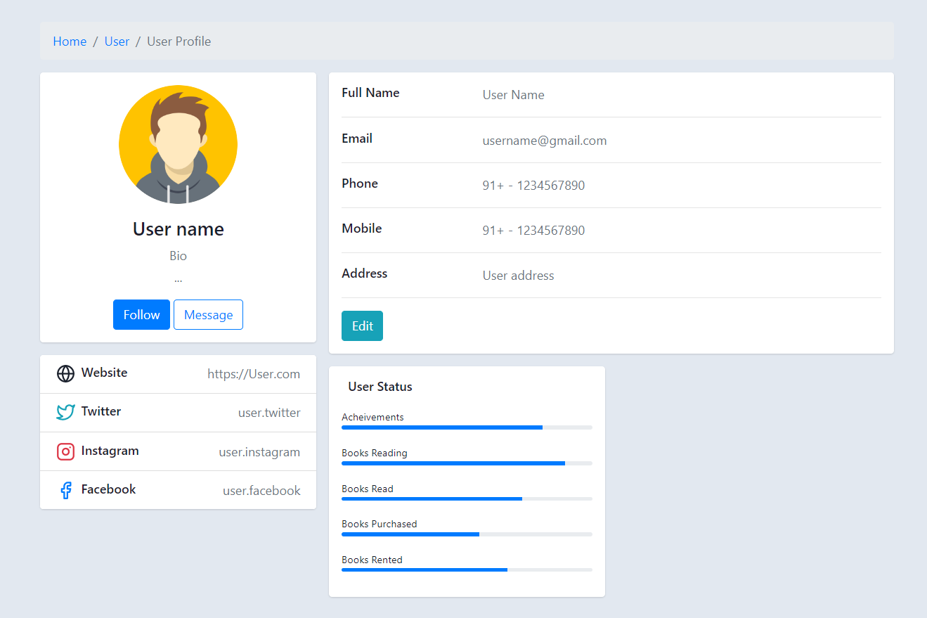

Slide 17
Division of work among the group members
2110030031 - Web Coding
2110030190 - Database creation
2110030109 - Database Modeling
2110030252 – Web page Modeling

Slide 18


